Slide 1

Secure Password Manager with Multi-Factor Authentication
CSA5115-CRYPTOGRAPHY AND NETWORK SECURITY
Presented by
N.S.V.L.Kavya-192373036
K Tejaswi Reddy - 192371036
K.Lahari Reddy-192411164
P.Pragna -192321061
Guided by
DR.T.Sangeetha

Slide 2


Abstract
The Secure Password Manager with Multi-Factor Authentication is a web application that enables users to securely store, manage, and retrieve their passwords. The system protects passwords using encryption and enhances security through One-Time Password (OTP) verification during login. It also maintains audit logs to track user activities. This project provides a secure, reliable, and user-friendly solution for protecting sensitive credentials and improving cybersecurity.

Slide 3
OBJECTIVES
To Allow trusted emergency contacts to request access to the vault after a designated timeout period if the primary user loses access.
To Enable users to share specific passwords securely with family members or team members via end-to-end encryption without exposing the plaintext.
To Provide browser extension or mobile app support to automatically fill usernames and login forms securely on verified websites.
To Ensure that the master password and encryption keys never leave the user's local device, meaning the service provider cannot read the user's stored passwords even if the server is breached.

Slide 4
PROBLEM STATEMENT
Weak & Reused Passwords: Users often rely on simple, memorable passwords or reuse the same credentials across multiple websites, leaving them vulnerable to mass breaches.
Credential Theft & Phishing: Cybercriminals exploit weak security practices through brute-force attacks, phishing, and credential stuffing to steal plaintext user accounts.
Insecure Storage Risks: Storing passwords in plaintext or using weak encryption leaves database compromises exposed to immediate data exfiltration.
Single-Factor Vulnerabilities: Traditional single-factor authentication (username and password only) fails to provide adequate protection if primary credentials are leaked.
Lack of Activity Visibility: Systems without comprehensive audit logging and session tracking make it difficult to detect, investigate, or prevent unauthorized account access

Slide 5
LITERATURE REVIEW
Title | Author & Year | Methodology | Inferences
Security Evaluation of Password Managers | Gallus et al. (2025) | Evaluated 10 password managers using penetration testing and security protocol assessments | Tools with strict zero-knowledge encryption, MFA, and strong hashing offer high resilience against breaches.
Zero Knowledge (About) Encryption | Scarlata et al. (2026) | Performed cryptographic analysis on cloud password managers under a malicious server threat model. | Flaws in key management can expose vaults, proving zero-knowledge requires rigorous authenticated encryption.
SecretCentric Hardware-Based Management | Nair & Song (2023) | Developed and tested an automated, hardware-assisted credential system with user studies. | Automating generation and rotation successfully tackles human error (reuse) without hurting usability.

Slide 6
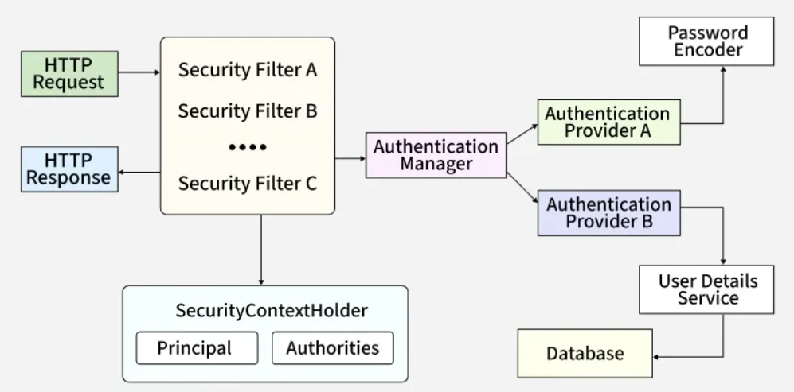
SYSTEM ARCHITECURE

Slide 7
Module 1: User Registration
Create Account: Assign a unique ID, set an account status, and log registration metadata.
Validate Info: Check syntax, sanitize input to block attacks, and verify uniqueness.
Store Securely: Use cryptographic password hashing, encrypt data in transit and at rest, and restrict access.
Enforce Passwords: Require strong complexity, check against breached password databases, and block weak patterns.

Slide 8
Module 2: Password Encryption & Storage
Save Credentials: Link usernames and passwords to their specific website domains in a centralized vault.
Encrypt First: Secure passwords using robust algorithms (like AES-256) before they reach the database.
Store Securely: Persist only the encrypted ciphertext while keeping encryption keys completely separate.
Prevent Unauthorized Access: Protect the vault using strict multi-factor authentication, strong master passwords, and automatic timeouts.

Slide 9
Module 3: OTP / Multi-Factor Authentication (MFA)
Generate OTP: Create a unique, short-lived code (via authenticator apps or SMS) that expires quickly.
Verify OTP: Validate the entered code, enforce single-use to block replay attacks, and apply rate limiting.
Additional Security: Add Multi-Factor Authentication by combining a password with something the user owns.
Prevent Access: Stop unauthorized account takeovers and credential stuffing, even if passwords are leaked.

Slide 10
Module 4: Password Retrieval & Audit Logs
Retrieve Passwords: Decrypt vault records using the user's authenticated session, enforcing strict data isolation.
Display Securely: Mask passwords by default, auto-clear clipboards, and protect the UI from unauthorized viewing or screen recording.
Record Login History: Log metadata like IP addresses, timestamps, and device types to track activity and spot anomalies.
Track Vault Changes: Maintain an audit trail of all password additions, updates, and deletions for security and recovery

Slide 11
Tools & Technologies Used
Java – Used to develop the core application logic.
Spring Boot – Used to build the backend and handle user authentication, OTP verification, and business logic.
HTML, CSS, JavaScript – Used to design and develop the user interface.
MySQL – Used to store user accounts and encrypted passwords securely.
Visual Studio Code (VS Code) – Used to write, edit, and debug the project code.
AES-256 Encryption – Used to encrypt passwords before storing them in the database.
Git & GitHub – Used for version control and project management.

Slide 12
CONCLUSION
The development of a Secure Password Manager with Multi-Factor Authentication addresses critical modern cybersecurity vulnerabilities by replacing unsafe user habits such as password reuse and weak patterns with a robust, end-to-end protected system.
Ultimately, this system delivers an optimal balance between maximum cryptographic security and seamless user experience, establishing a reliable framework for safely managing digital identities in an increasingly threat-prone digital landscape.
Maintains immutable activity and session logs that track login metadata and vault modifications, providing accountability, anomaly detection, and rapid troubleshooting capabilities.

Slide 13
Future Scope
Fingerprint & Face Unlock: Add support for biometrics (like Touch ID or Face ID) so users can open their vault quickly and securely.
Passkey Login: Move toward passwordless login using modern digital keys to completely stop phishing attacks.
Safe Sharing: Allow users to share specific passwords securely with family or friends without revealing the actual password.
Auto-Update Passwords: Build features that automatically change weak or hacked passwords on websites for the user.
Smart Security Alerts: Use smart detection to catch weird login locations and block suspicious activity instantly.

Slide 14
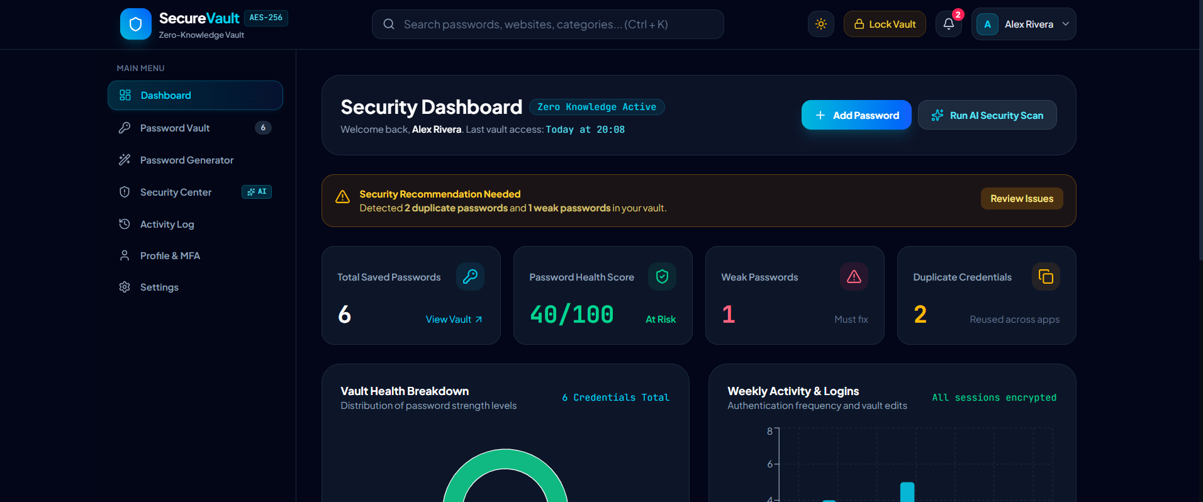
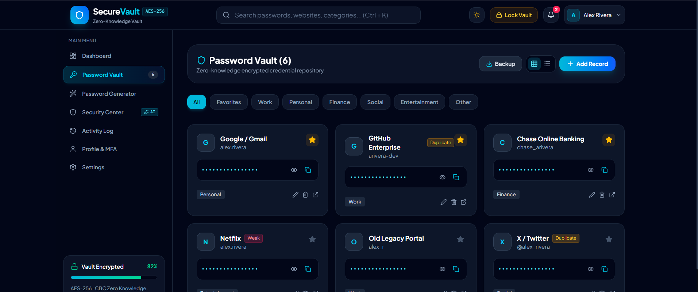
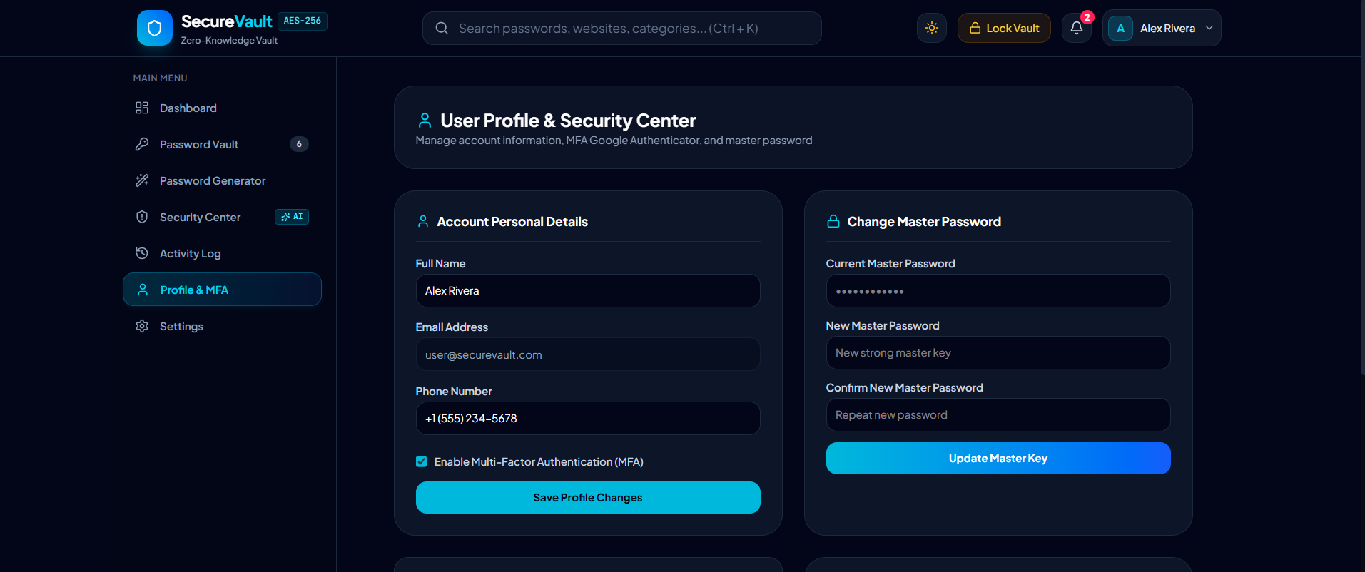
OUTPUT

Slide 15
REFERENCE
[1] S. Gallus, J. Staněk, and P. Klaban, "Security Evaluation of Password Managers: A Comparative Analysis," Journal of Cybersecurity and Privacy, vol. 5, no. 1, pp. 45–62, 2025.
[2] M. Scarlata, S. Torrisi, K. Backendal, and K. G. Paterson, "Zero Knowledge (About) Encryption: A Comparative Security Analysis of Three Cloud-based Password Managers," in Proceedings of the IEEE Symposium on Security and Privacy (SP), San Francisco, CA, USA, 2026, pp. 1120–1135.
[3] S. Amft et al., "‘We’ve Disabled MFA for You’: An Evaluation of the Security and Usability of Multi-Factor Authentication Recovery Deployments," in Proceedings of the 2023 ACM SIGSAC Conference on Computer and Communications Security (CCS '23), Copenhagen, Denmark, 2023, pp. 24–38. doi: 10.1145/3576915.3623180.
[4] National Institute of Standards and Technology (NIST), "Digital Identity Guidelines," NIST Special Publication 800-63B: Authentication and Lifecycle Management, Gaithersburg, MD, USA, 2020.
[5] OWASP Foundation, "Multifactor Authentication Cheat Sheet," OWASP Cheat Sheet Series, 2026. [Online]. Available: https://cheatsheetseries.owasp.org/cheatsheets/Multifactor_Authentication_Cheat_Sheet.html

Slide 16
Thank You!

